Slide 1

Hotel Management System

Slide 2
Concept
Centralized Management of rooms, guests, bookings and staff
Streamline Operations to reduce manual errors and paperwork
Real-Time Visibility of room availability and occupancy
Data-Driven Decisions through automated reporting

Slide 3
System Overview & Requirements
Manage hotel operations: rooms, guests, bookings, employees
Requirements
Room availability & dynamic pricing
Guest registration & profile management
Booking/reservation entry and modification
Occupancy tracking & status reports
Employee directory & role assignments

Slide 4
Operations
Insert
Insert new rooms, guests, booking records, and employee records.
Update
Update room details, guest information, booking dates, and employee information.
Delete
Delete records for rooms no longer available, guests who checked out, canceled bookings, or employees who have left the hotel.
Query
Query available rooms, guest booking history, current occupancy status, and employee details.

Slide 5
Key Entities
Room
Represents an individual accommodation unit
Attributes: RoomID, RoomType, PricePerNight, Availability status
Guest
A customer who stays at the hotel
Attributes: GuestID, Name, Email, Phone, Booking history
Booking
Links a Guest to a Room for specific dates
Attributes: BookingID, RoomID, GuestID, CheckInDate, CheckOutDate, EmployeeID
Employee
Hotel staff member responsible for operations
Attributes: EmployeeID, Name, Role, Email, Phone

Slide 6
Constraints
Primary Keys: RoomID, GuestID, BookingID, EmployeeID
Foreign Keys:
Bookings(RoomID) references Rooms(R_ID)
Bookings(GuestID) references Guests(G_ID)
Bookings(EmployeeID) references Employee (EmployeeID)
Availability must be either 'Available' or 'Booked'
CheckOutDate must be greater than CheckInDate

Slide 7
Tables
Rooms
RoomID (PK), RoomType, PricePerNight, Availability
Guests
GuestID (PK), Name, Email, Phone
Bookings
BookingID (PK), R_ID (FK), G_ID (FK), CheckInDate, CheckOutDate, EmployeeID (FK)
Employees
EmployeeID (PK), Name, Role, Email, Phone

Slide 8
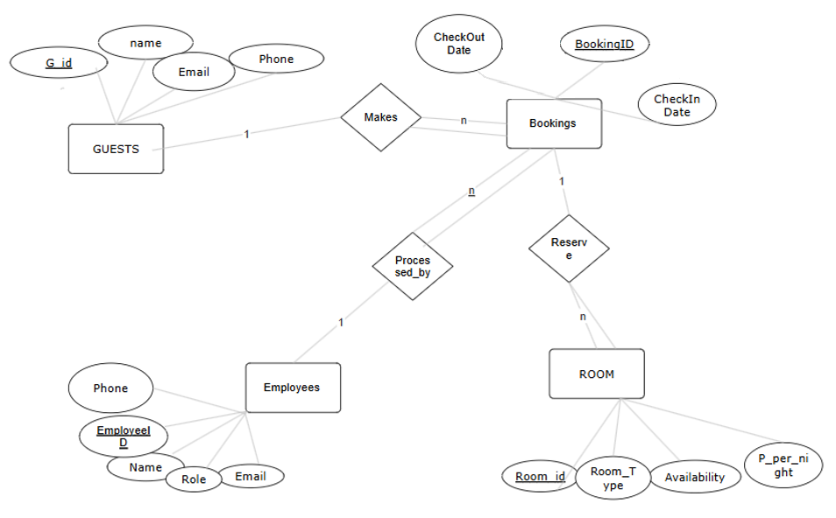
ER-Diagram

Slide 9
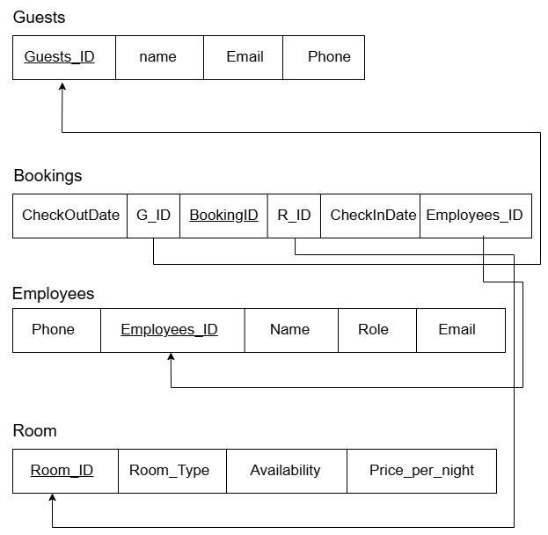
Schema

Slide 10
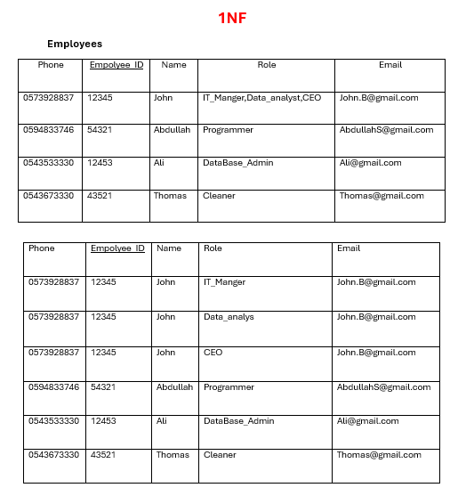
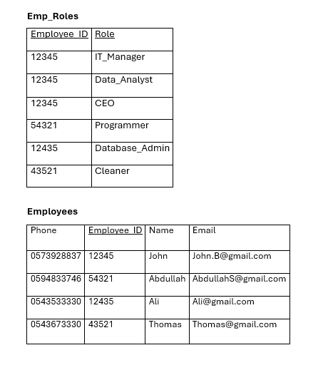
Normalization

Slide 11
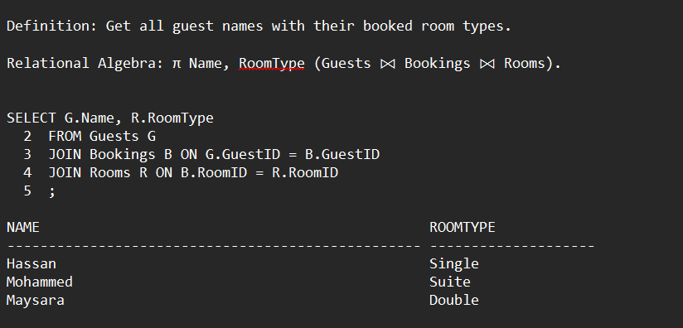
Queries

Slide 12
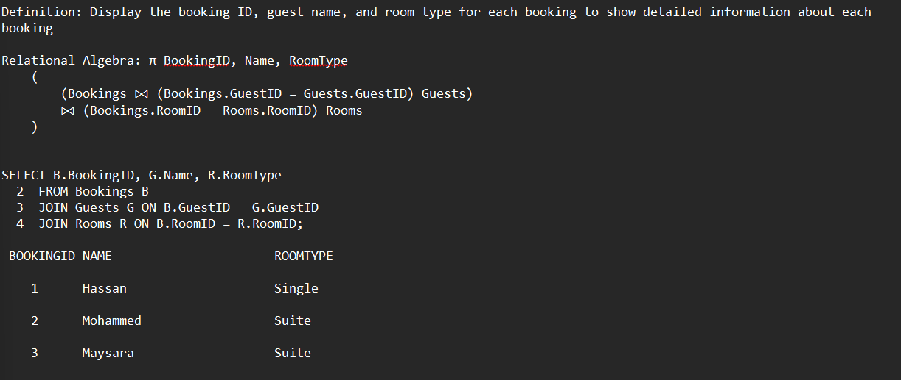

Slide 13
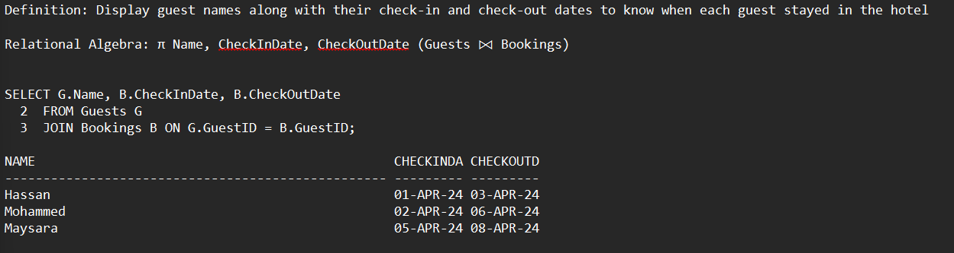

Slide 14
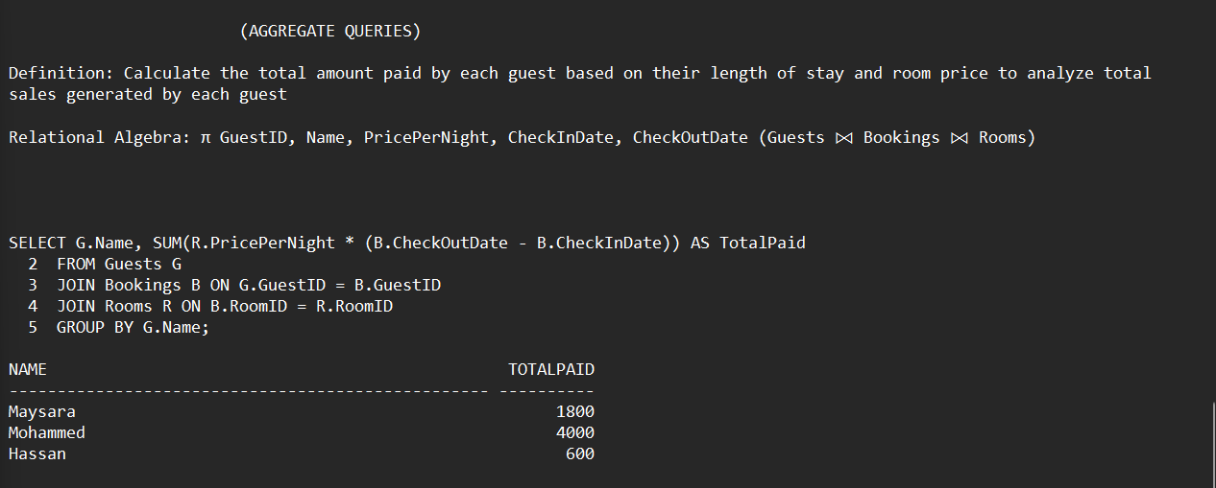

Slide 15
